Slide 1




Tips and Tricks of a successful proposal
PRIMA is supported under
Horizon 2020, the European Union’s
Framework Programme
for Research and Innovation
08 -02-2024

Slide 2



Content
  1
Excellence
  2
Impact
  3
Implementation

Slide 3
Excellence
1.1 Objectives
1.2 Relation to call and/or topic
1.3 Concept and methodology (a) Concept
(b) Methodology
1.4 Ambition
2. Impact
2.1 Expected impacts
Pre Proposal
STAGE 1
10 pages
2.2 Measures to maximise impact
a) Dissemination and exploitation of results
b) Communication activities
3. Implementation
3.1 Work plan — Work packages, deliverables
3.2 Management structure, milestones and procedures
3.3 Consortium as a whole
3.4 Resources to be committed
4. Members of the consortium
4.1. Participants (applicants)
4.2. Third parties involved in the project (including use of third party resources)
5. Ethics and Security
Full Proposal
STAGE 2
50 pages

Slide 4
FIRST STAGE
(max 10 pages)
1 - Excellence
  1.1 Objectives: overall and specific objectives
  1.2 Relation to call/ topic: how your proposal addresses the challenge & scope
  1.3 Concept and Methodology
(a) Concept: main ideas, models or assumptions
(b) Methodology: overall methodology, activities
1.4 Ambition: beyond the state-of-the-art
2 - Impact
2.1 Expected Impacts: expected impacts mentioned in the work programme

Slide 5

Excellence
1.1. Objectives : Overall and Specific (1-2 Pages)
Objectives should be consistent with the expected exploitation and impact of the project.
Be precise and specific as much as you can
Avoid too ambitious goals, over estimation
Reflect what is already written in the call text, read it again, again, and again -> reflection

Slide 6






Excellence
1.2. Relation to call: how your proposal addresses the challenge & scope
  Reflection from the call text, again.
  Alignment with PRIMA SRIA + CALL + TOPIC (+ EU relevant policies and strategies)
  You can use a tabular form.
  Relevance to the particular demands of the MEDA countries, where the action will be organized, and the relevant sectors (including synergy with other initiatives)

Slide 7
Excellence
1.3. Concepts and Methodology (4 pages)
(a) Concept: main ideas, models or assumptions
Explain Overall concept underpinning the project.
Identify inter-disciplinary among stakeholders’/partners’ knowledge and roles.
Include measures for public/societal engagement.
Positioning the project, spectrum from ‘idea 2 application’, ‘from lab 2 market’.
Technology Readiness Levels Refer to the initial TRL + the final TRL and what type of deliverable (i.e. new device) that would be resulted from the action/project.
Describe any national or international R&I activities which will be linked with the project (synergy and complementarity);

Slide 8
Excellence
1.3. Concepts and Methodology
(b) Methodology: overall methodology, activities - from objectives to results?
Describe overall methodology (applied approach – not detailed activities and steps)
Present the state-of-the-art of the technologies used and its rational.
Present the logic behind the Workpackages structure, not the details.
Distinguishing, as appropriate, activities indicated in the relevant section of the work programme, e.g. for research, demonstration, piloting, first market replication, etc;
Describe gender dimension

Slide 9
EXCELLECE
1.4 Ambition: beyond the state-of-the-art (1 Page)
What the proposed project would advance/go beyond the state-of-the-art, and the extent the proposed work is ambitious (Novelty of your project and added values).
Describe the Innovation Potential (e.g. ground-breaking objectives, novel concepts and approaches, new products, services or business and organisational models). Where relevant, refer to products and services already available on the market. Please refer to the results of any patent search carried out.
why you choose this/these technologies, advantages over alternatives in the market.
In brief, also describe the nature and size of the tackled market.

Slide 10
EXCELLECE
Criticism from Evaluators
Key objectives are described mainly in broad terms, with specific objectives only listing work plan tasks.
The proposal insufficiently develops the needs, the problems and the opportunities of the project stakeholders.
There are only weak links between the objectives and the work plan. In some cases it does not become clear how the objectives will be addressed in each of the work packages.
Alternative production methods are not appropriately quantified and compared; so that the evaluation of the techno-economic contribution is not entirely convincing.

Slide 11
IMPACT
2.1. Expected Impacts
2.2. Measures to maximise impact
Dissemination and exploitation of results
Communication activities
Stage1
Stage2

Slide 12
IMPACT
2.1. Expected Impacts (2/3 Pages)
Be CLEAR and SPECIFIC to your proposed project and its objectives, avoid general terms.
USE QUANTIFIED KPIs AND TARGETS/VALUES, Means of VERIFYING/MEASURING.
Classify Impacts: Social, Economic, Environment, Political, Technological advancement.
Define TARGET GROUPS and BENEFICIARIES (i.e. small farmers, organic food market…) and the geographical coverage (involved countries).
Describe how your project will contribute to each of the expected impacts mentioned in the PRIMA AWP, (Topic: Expected Impact).
Do not forget the Cross cutting areas (i.e. ICT revolution, gender issue,….)
Expected impacts (Topic) | Project’s out put contribution | KPI | Expected Value
Expected Impact | Stakeholders Beneficiaries | Project Outcomes

Slide 13
IMPACT
2.2. Measures to maximise the impact
a) Dissemination and exploitation of results
Provide a draft plan for the dissemination and exploitation of the project’s results
The plan, should be proportionate to the scale of the project, and should contain measures to be implemented both during and after the end of the project. For innovation actions, in particular, please describe a credible path to deliver these innovations to the market.
What do you want to disseminate, to Whom, Why, How and When.
All partners need to be involved
Explain what specific stakeholders you are targeting with each activity
How often the dissemination plan may be updated, why and by whom
Use a table indicating how the impact of dissemination will be measured, also include a contingency plan

Slide 14
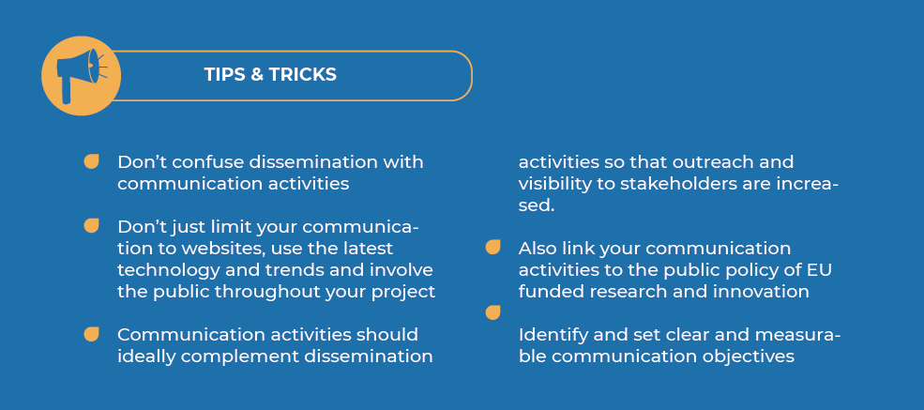
IMPACT
2.2. Measures to maximise the impact
b) Communication activities

Slide 15
IMPACT
IMPACT : Key Points
Ensure the project will meet each of the “expected impacts”
Identify further impacts not outlined within the call
Make sure your proposal is challenge-led and links to the expected impacts for your call throughout the proposal, not just in the sections dedicated to impact. Make sure that each of the impacts is linked to research in your work programme
Make your impact goals specific and measurable by identifying indicators

Slide 16
IMPACT
Criticism from Evaluators
In the dissemination strategy a clear targeted strategy to reach different stakeholders’ groups is not well mentioned
The performance indicators for dissemination are not ambitious
The possibility to set up training workshops towards end users as a way to decrease the barrier for adoption of the project results is not considered enough,
Ability to effectively replicate the concept and technology throughout Europe is not evident,
Exploitation plan is absent/partial or vague
Lack of details on IPR management

Slide 17
IMPLEMENTATION
Implementation is the bridge between the concept and the ultimate project goals*
This section must show that the work is planned in a coherent manner, that the timeline makes sense and that you also have a plan in case something goes wrong
Work plan — Work packages, deliverables
Management structure, milestones and procedures
Consortium as a whole
Resources to be committed

Slide 18

3.1. WORK PLAN- WORK PACKAGES - DELIVERABLES
WORK PLAN
1 Page
You have to provide the following
Brief Presentation of the overall structure of the Work Plan
Timing of the different work packages and their components (Gantt Chart)
Detailed Work packages
  A list of WP (Table)
  A description of each WP
  A list of major deliverables
Graphical presentation of the components showing how they interrelate (Pert Chart )
2-3 pages per WP
trategic Research and Innovation Agenda
raft - August 10th 2017

Slide 19
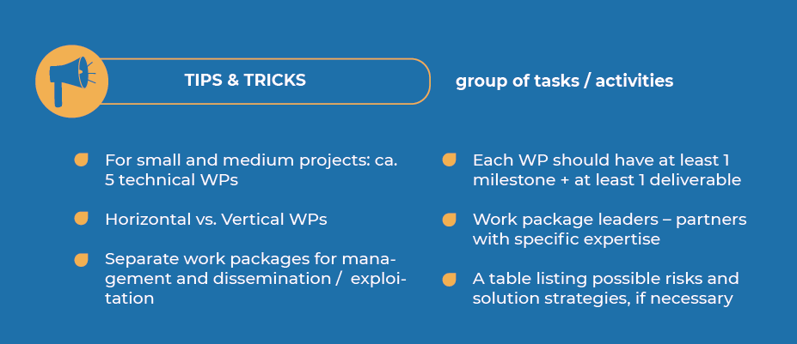

Slide 20
Criticism from Evaluators
The Workplan does not fully specify the activities to be performed with regard to xy
There is an imbalance in the allocation of resources in WP2,3,4,6,7, Each is dominated by a single partner and the proposal does not fully explain why this is appropriate
Some of the key tasks are not described in enough detail to fully appreciate if the project is feasible and if the main aims are actually achievable
The Gantt chart is missing the inclusion of tasks and WP6- which is relevant for the achievement of the proposal objectives – is missin milestones
The diversity and complementarity of the consortium partners is insufficiently highlighted
There is no clearly identified partner who will drive the commercial exploitation of the proposal results

Slide 21






PRIMA Programme is supported under Horizon 2020, the European Union’s Framework Programme for Research and Innovation.
Thank You, GOOD LUCK with CALLS 2024
PrimaProgram
@PRIMAProgram
Prima Program
Prima-med YouTube

