Slide 1
Competitive Coordinated Proposal for PRIMA Programme
Dr. Omar Amawi – Deputy Director
PRIMA is supported under
Horizon 2020, the European Union’s
Framework Programme
for Research and Innovation
PRIMA is supported under
Horizon 2020, the European Union’s
Framework Programme
for Researc and Innovation
08 -02-2024

Slide 2
Content
PRIMA Achievement (2018-2023)
A Focus on Tunisia Achievement (2018 -2023)
Coordinated proposal by Tunisian teams
- Overview of coordinated proposals
- Main Raisons for Rejection

Slide 3
PRIMA ACHIEVEMENTS BOARD (2018-2023)
2,400+
21K+
ALL
239
# of funded projects (16 MPC coordinators)
# of total eligible submissions
# of participating entities
PRIMA PS received funds
352 M€
30%
20%
2310+
Total Budget Allocated
MPC Total Budget Share
Budget Share of Private Sector
# of Total Beneficiaries
53
96
77
13
# Water projects
# Farming projects
#Agro Food projects
# Nexus projects

Slide 4
TUNISIAN ACHIEVEMENTS BOARD (2018-2023)
1,300+
1.900
150
229
# of total eligible submissions
# of participating entities
# of funded projects)
# of Beneficiaries entities
19.9 M€
87.3K€
11.5%
7
Total Budget Allocated
Average Budget/
LE Entity
Success Rate
Coordination
33
63
47
7
# Water projects
# Farming projects
#Agro Food projects
# Nexus projects

Slide 5
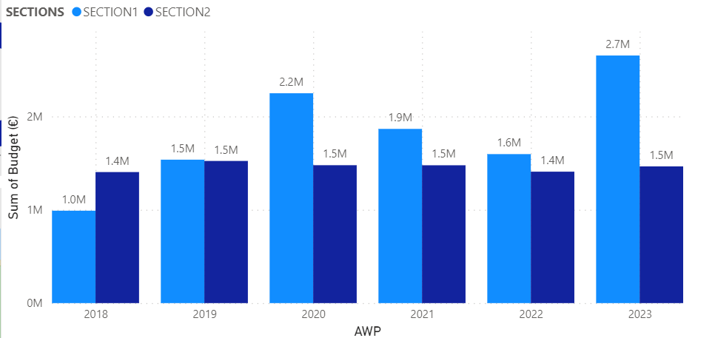
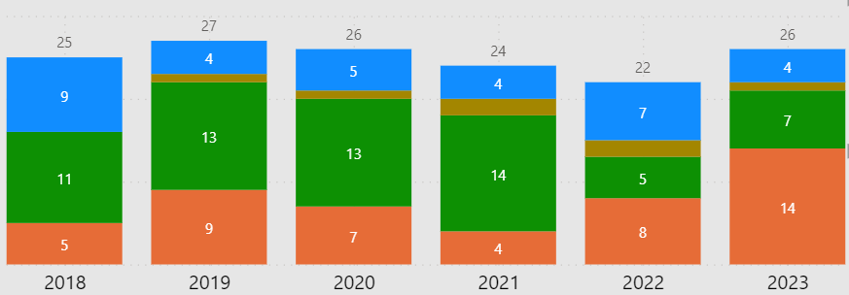
TUNISIAN ACHIEVEMENTS BOARD
Budget Per Year
#Projects Per Year

Slide 6
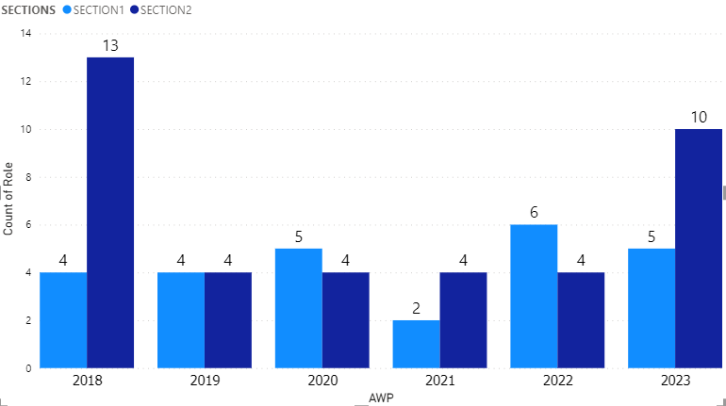
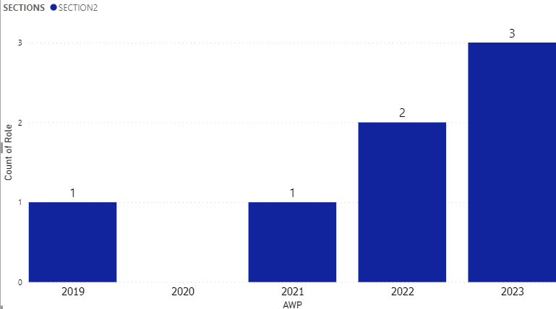
Coordination
Submitted
SECTION1
SECTION2
Funded
Success Rate of coordination : 10.7%
No Coordination in Section1

Slide 7
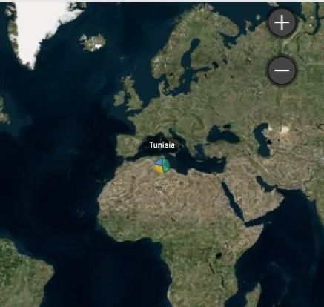
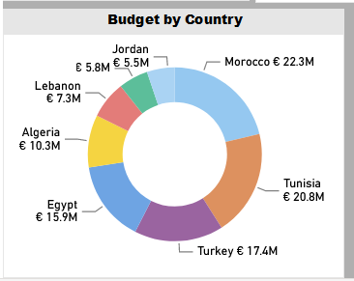
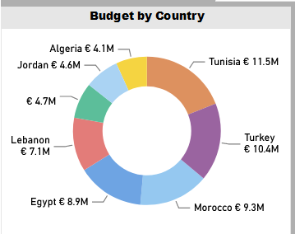
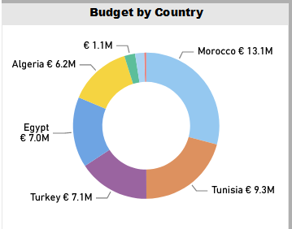
Budget
MPCs, Section 1&2
SECTION1
SECTION2

Slide 8
Raisons for Rejection
Excellence
Impact
No details on the methodology
No innovation in the proposal
The proposal is too general
The proposal is only academic
Not building on existing projects or data bases
No relation with other initiative like mission soil
No literature cited-no solid background
Too ambitious and not realistic
Only technological project, no added value for new methodology or knowledge
The proposal fails to clearly display the state of the art and show where the proposal would go beyond
A considerable number of objectives are presented, but they are poorly described. Therefore, the description is too vague and cannot be related to the project objectives and the methodology proposed.
No clear outline of the Technology Readiness Level
Absence of indicators (KPIs)
The proposal includes the list of KPIs mentioned in the call topic text, but it does not provide any quantified values or qualitative descriptions
The proposal fails to sufficiently establish links between the KPIs and the expected impacts
The proposal lists the expected impacts required by the call, but it does not specify how the project will contribute to achieve these impacts
Dissemination plan is not sufficient described

Slide 9
Thank you
PrimaProgram
@PRIMAProgram
Prima Program
Prima-med YouTube

